Slide 1
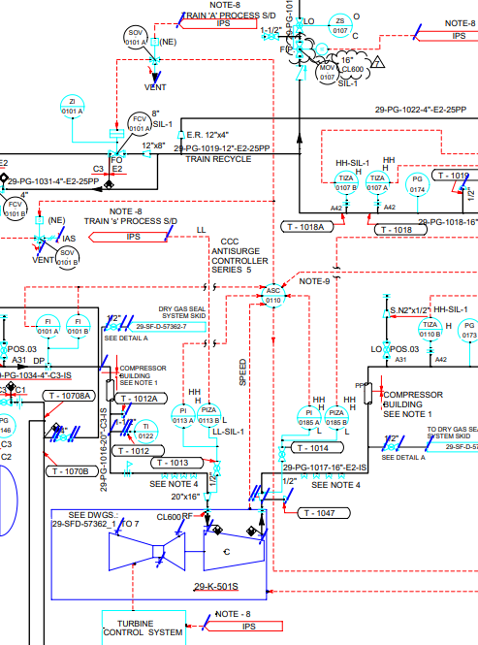

AI for Smart P&IDs
AI model which unifies text, symbols recognition

Slide 2

AI for Smart P&IDs
Conceptualized by Lavanya Sreeram
17 May 2023

Slide 3
Digital Transformation and Legacy Systems
Digital Transformation!
It’s the need and inevitable trend that companies are moving toward.
Major part of transformation involves digitizing Engineering Drawings – paper drawings, PDFs.
Current situations are:
Drawing digitization is done manually
Drawing digitization/conversion is not started

Slide 4
Businesses are wanting & waiting for the easy solution
Reference:
CR-PB-163578 - SPPID To Support Import and Conversion of Legacy Flat-filed P&IDs to Smart P&IDs

Slide 5
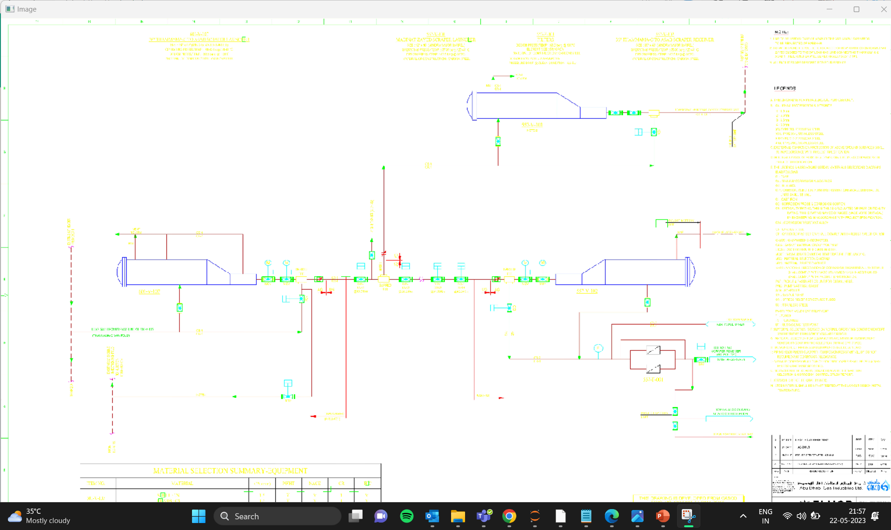
Output 1– Object Detection ---gives symbols, location

Slide 6
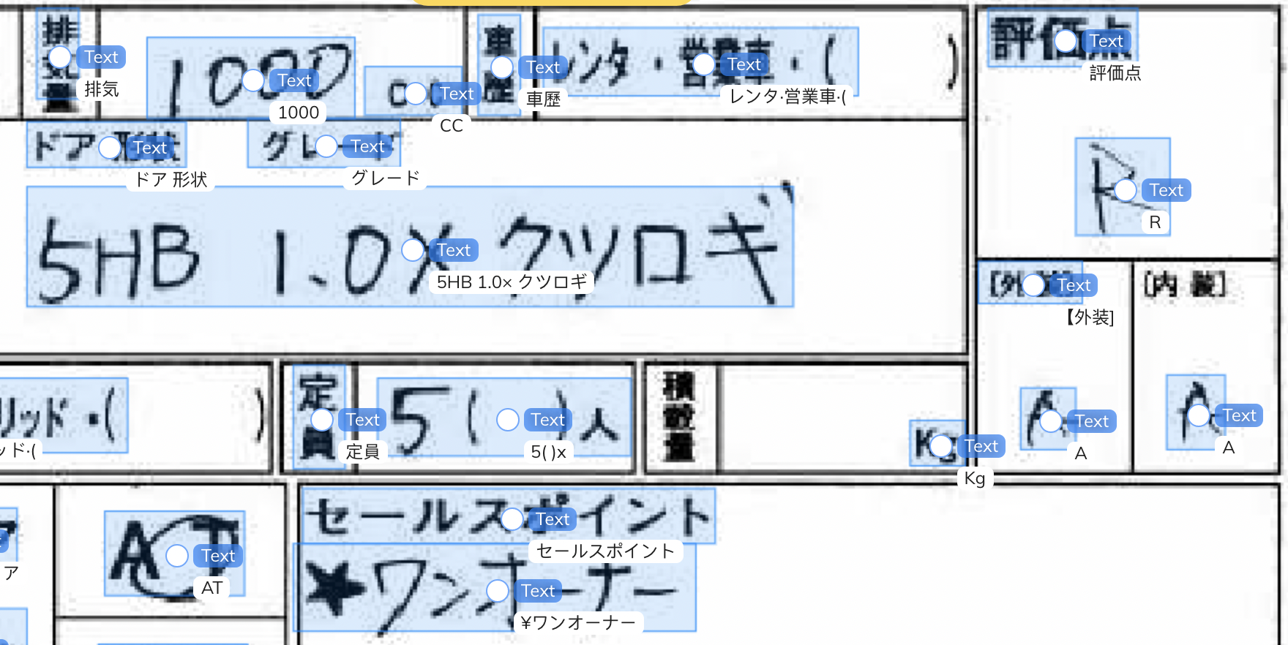
Output 2 – Text Extraction using OCR. ---gives Text & Tag information.

Slide 7
Business Requirement
Symbols, sym file name, location
Tag, Text
Create Smart PID using PLAICE

Slide 8
Proposed Solution – AI for Smart P&IDs
AI model which unifies text, symbols, engineering attributes, drawing template sizes
Integrates with Smart P&ID – data imported/created in Hexagon Smart P&ID
Proposed AI solution will extract key information from PDFs.
Convert the engineering schematics / P&ID PDFs into Smart P&IDs with no coding required for end user businesses.

Slide 9
Pre-processing PDFs for Training in Symbol Recognition- Also called ‘Labelled’ Training Data
Assumption – Hexagon Smart PID drawings which will be used on training for first phase model will be closely similar to AutoCAD PDFs, flat-filed PDFs
Pre-process Smart P&IDs - using Plaice Automation
Start with Smart P&IDs
Remove symbols that are of Label/Text Category using Plaice Automation
Place new single Text Label on each Item that displays the symbol name, symbol type→ Literally labelling the dataset
Batch convert these Smart P&IDs to PDFs (To diversify train dataset color & B&W, 1200dpi, 900 dpi & below)
This will be the train dataset or labelled data for the AI/ML model.
…contd.

Slide 10
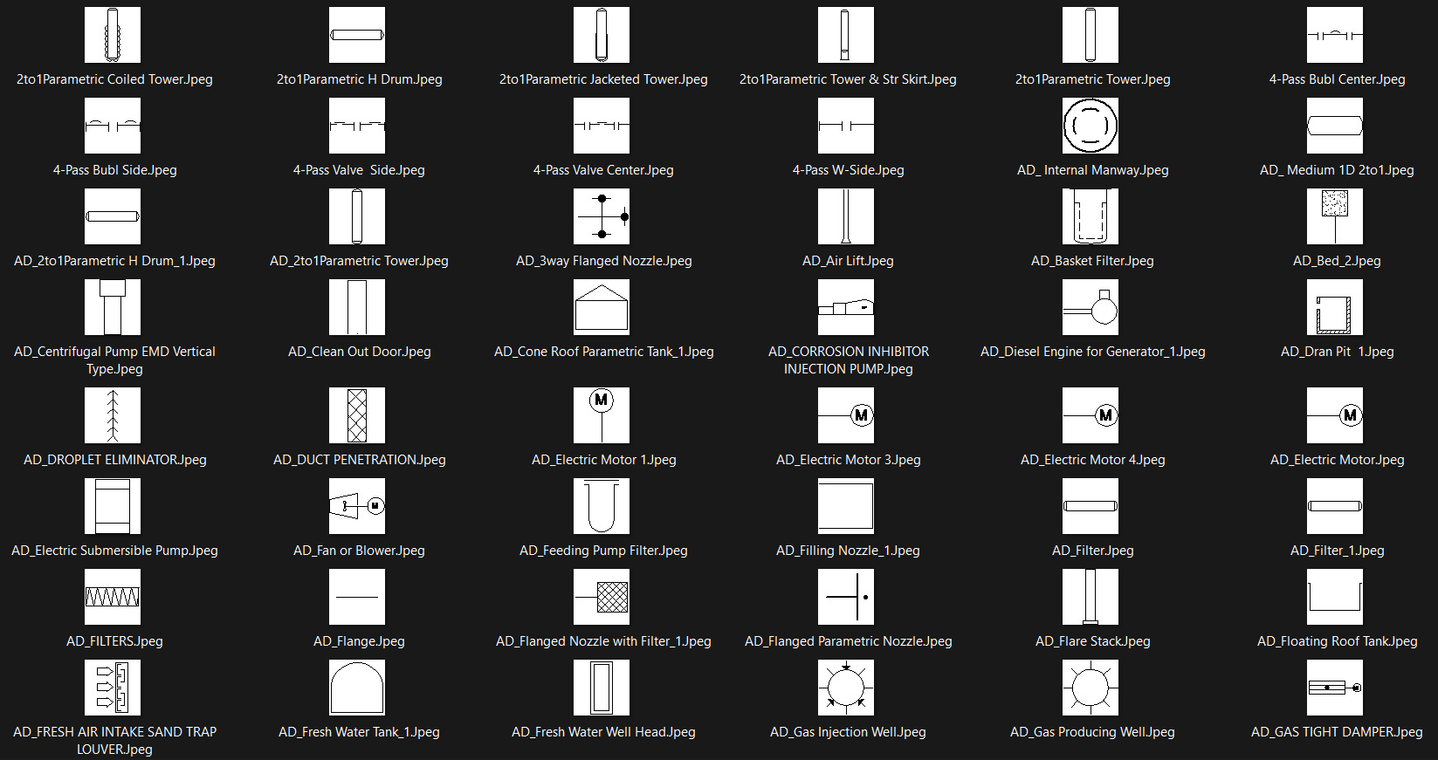
Existing Shapes or Symbol legend:

Slide 11
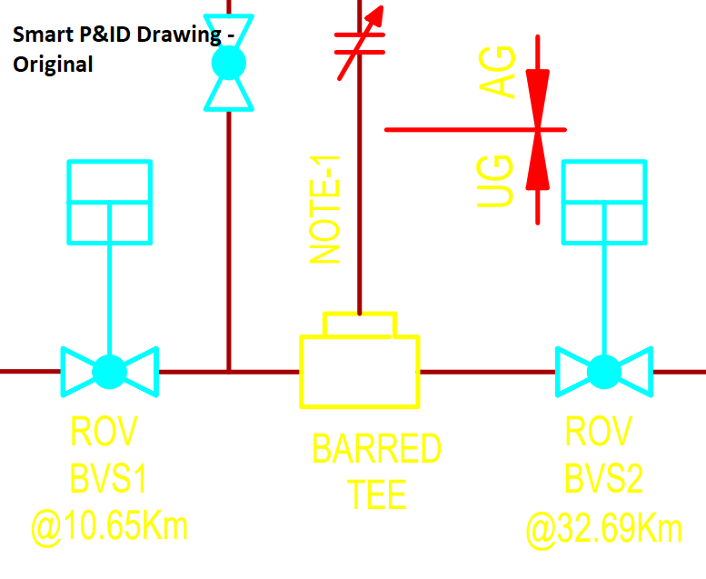
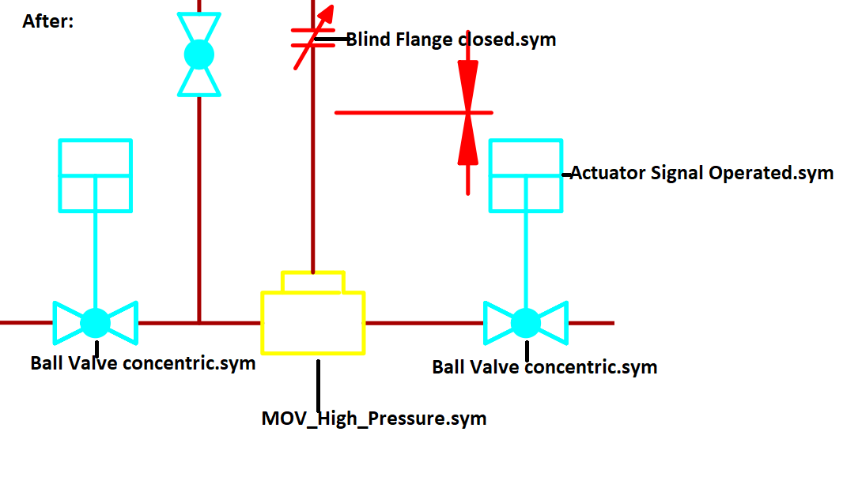
Pre-processing Smart P&ID to create training dataset

Slide 12
Text Extraction using OCR

Slide 13
Model Train - Overview
Train the model on PDFs- supervised learning
Identify & Extract Symbols from PDFs – using objection detection
Match symbol to Ground truth
i.e. Hexagon symbol legend– using similarity or classification
Also, Identify & Extract Tags using – OCR / text recognition
Integrate with Smart P&ID
Use above symbols & Tags as input
Create Smart P&IDs using Plaice llama automation
Update Tags – Create Smart PIDs
Legend- Hexagon Technology - ML Techniques
Notes:
By combining object detection and OCR techniques, you can achieve a comprehensive conversion process for PDFs to Smart P&IDs. Object detection helps in accurately identifying and extracting the symbols, while OCR assists in extracting the associated textual information. This combined approach ensures that both the visual representation of the symbols and the associated text are captured and utilized effectively in generating intelligent P&IDs.
It's important to note that the effectiveness of the conversion process depends on the quality and consistency of the PDFs, the complexity of the symbols, and the accuracy of the object detection and OCR algorithms employed. Customization and fine-tuning of these techniques may be necessary to meet specific requirements and achieve optimal results for converting PDFs to Smart P&IDs.

Slide 14
ML Model Test – Technical Overview
Testing for:
Speed
F1 Score for Symbol extraction
F1 Score for Text Extraction
Note : F1 score is a metric that helps to find right balance between correctly identifying positive instances and minimizing false positives and false negatives
Pre-process test PDFs into images
Predict Symbol of Image using model. Extract Text
Performance Metrics / F1 Score

Slide 15

Schedule
Create Train dataset –i.e. PDFs, Distinct Symbol Legend, Text 4-6 weeks
Apply model, run multiple models for best model, test
2-3 weeks
Integrate with Smart P&ID, Test
4-6 weeks
Handover!

Slide 16

User Homework / configuration
Notes:
Let us talk configuration. We are hoping all done well, user will be able to upload the symbol legend as PDF drawing. One set of Smart P&ID symbols available and placed in Reference Data. This will be the only configuration needed from user’s perspective. This provision of PDF legend and symbol legend wil add as an additional fine tune training as per customer’s custom symbols, that’s all. It will be like choosing skin tone for emojis when all else is in place.

Slide 17
Scope
Integrate a refined & targeted version of already developed Hackathon PHDv2.0 2019 Winning Idea “IntelliDraft”.
References to “IntelliDraft”:
CR-OT-10569 : Intelligent PID Drafting by showing Top5 relevant symbols as recommendation
RI-PB-229800 : Recommendation Engine for Smart Catalog Explorer in SPID

Slide 18

Thank you
Review by NAINALA Rahul
-Software Engineer, Hexagon ALI Services, India

Slide 19
Resources used:
https://smallpdf.com/result#r=49cef9ac2e4e587c80aee0dadd4edb06&t=extract
Python, OpenCV, OCR
Hexagon SmartP&ID Plaice Automation

